Slide 1
Forest Fires
By
Satish Gollu
Sri Surya Sameer Vaddhiparthy
Naveen Kumar Paka
Under the guidance of Dr. Alvis C Fong

Slide 2
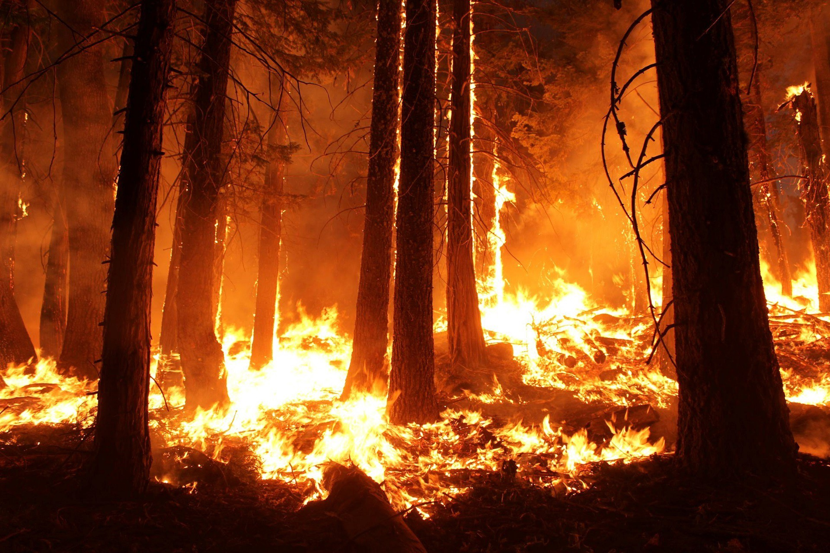
Overview
Issue: Over the years, the number of forest fires around the world are on the rise with increasing use of technology and ease of human life, we are losing a lot of forest cover which are the lungs of our planet, loss of habitat for many species
Current Approach: Analyze the data on forest fires to predict the Area of forest that can potentially be affected given environmental conditions like humidity, temperature etc.
Hypothesis: Scientists told that regression task on this dataset is hard and R^2 is less than 20%
Dataset source: https://archive.ics.uci.edu/ml/datasets/forest+fires

Slide 3
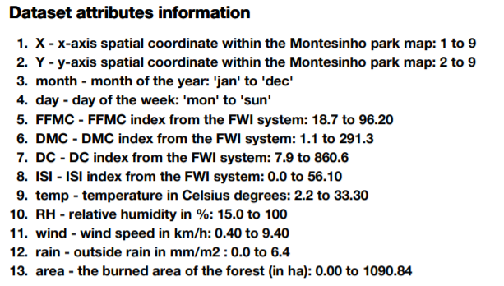
Dataset Description
Data Set Characteristics | Multivariate | Number of Rows | 517
Associated Tasks: | Regression | Number of Columns | 13

Slide 4
Steps undertaken
Checking missing values
Checking skewedness and Kurtosis
Checking Outliers
Analyzing various types of variables
Checking month with most instances
Treating outliers
Encoding Categorical Variables and scaling
Transforming skewed variables and checking correlation
Dividing dataset
Performing Linear Regression
Polynomial Regression

Slide 5
Key Conclusions
We failed to reject null hypothesis as the R^2 is less than 50%

Slide 6
Thank
You.

